Slide 1


Welcome to Raa
Making of a Raa Ram!

Slide 2
Important People to Know
Dr. Scott
Mr. Lynch, Mrs. Van Camp, & Mr. Crouch
Ms. Kerrigan and Ms. Robinson
Ms. Alford
(New Athletic Director)
Ms. Savage
Principal
Administrative Team
Our Guidance Team
6th Grade Team Leader
Our Athletic Director
Technology Coordinator
Notes:
Email Mr. Wyly for information about football try-outs and conditioning at wylya@leonschools.net
All other Fall sports try-outs will be at the start of school but School Physicals and Activity Forms must be on file

Slide 3
Important Information
Join our Raa Listserv
School Hours and Bell Schedule
Raa offers a before school and after-school EDEP program
Dress Code for middle school
Notes:
How do they join listserv?

Slide 4
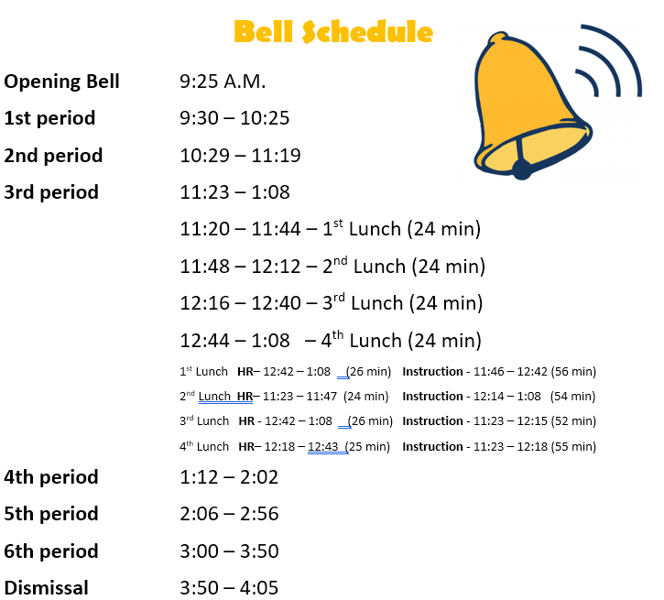
Notes:
Bell Schedule Notes
Lunch Time
No lockers
Should have backpacks

Slide 5
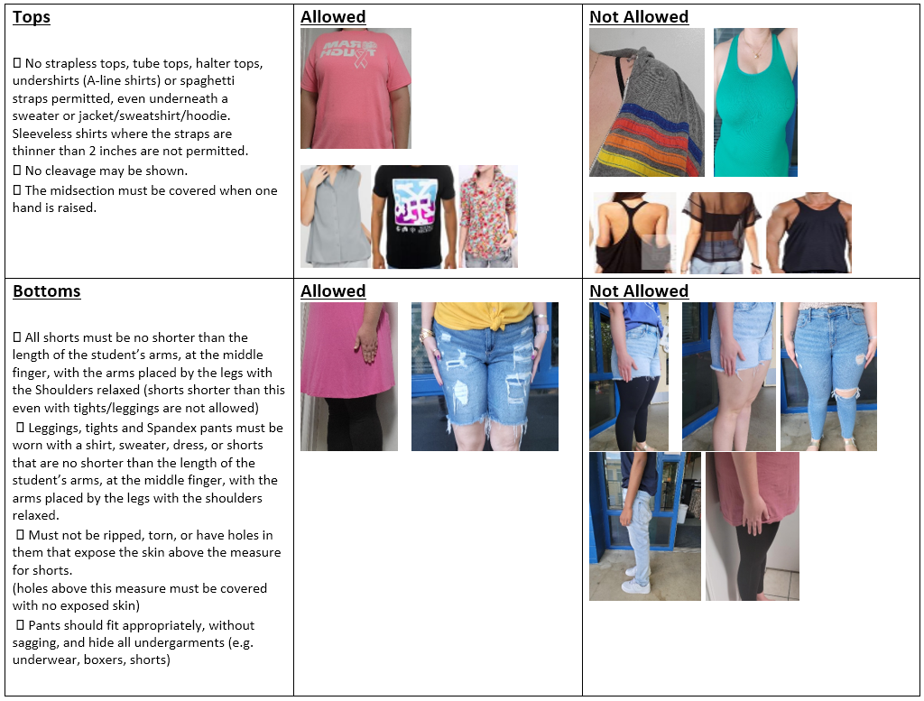
Dress Code

Slide 6
Upcoming Dates
Return Course Request forms to your elementary school by May 12th
Summer 6th Grade Orientation Camp
  Select One Day: July 18, 19, or 20
  A sign-up form will be posted on our website
Questions about Bus Routes can be directed to Transportation (487-7100)

Slide 7

One Day Camps
July 18, 19, 20 (Choose One)
8am – 1pm
$30 per student
Notes:
Send flyer and information will be added to our website. A sign-up Form will be available so that parents can reserve their date. We can host up to 50 students per day.

Slide 8

“Intelligence plus character, that is the goal of true education.”
Martin Luther King, Jr.
Notes:
Some of the biggest lessons learned in middle school don’t involve textbooks. Middle School starts the training ground for students’ next steps in life and in their professions. We want them to learn some independence in learning how to be successful; self-advocacy by learning who they are and what they want to stand for and associate with; and lastly how to ask for help both about peer relationships and school work.

Slide 9
Key Differences for Middle School
Bell Schedule
6 classes with 4 minute transitions between classes (organization)
25-minute lunches where they socialize with friends
Dismissal - please make sure that your middle schooler knows your phone number and address
Notes:
School Supplies-we will provide planner
Normal School supplies include paper, pencils, folders, and 3-ring binder to get started. Teachers will request any specialized supplies in their course syllabi. Show list on website.

Slide 10
Technology
Chromebooks travel with students and must come to school charged every day.
Canvas is the virtual classroom for students and parents to access the curriculum.
FOCUS is the student information system for grades, schedule, and attendance.
Communication with teachers should be through our leonschools.net email address. NOT Canvas or FOCUS messages.
Cell phone usage - students may have their cell phones in their backpacks but cannot use them during the school day. Parents should call the front office to get messages to their students.
Notes:
Emphasize communication with teachers
Keep track of grades and attendance in Focus – Teachers post grades, at minimum once every 2 weeks. Most teachers post more often (after large grades)
Questions should be emailed to teachers and administrators

Slide 11
Clubs and Athletics
Sixth grade students are automatically eligible for the Fall sports. A 2.0 gpa is required for all other sport seasons.
  Cheerleading
  Football
  Cross Country
  Volleyball
  Baseball (New!)
The Athletic Director must have an up-to-date Physical and Activity form on file for students to try-out or practice.
Any students can join a club! Most meet before school at 8:45.
Notes:
Emphasize the forms for sport participation
Clubs: Future Builders of America, Fellowship of Christian Athletes
We are always open to adding more clubs! If enough students are interested, all you need is a teacher sponsor and you have a new club!

Slide 12
Raa Arts Magnet
Offers more electives than any other middle school in Leon County
Give students the opportunity to explore and hone their creative passions
No prerequisite arts experience required but enthusiasm is a must!
PE Waiver

Slide 13
PTO Involvement
Monthly Meetings
Opportunity to celebrate our Raa Students
Opportunities to support our community through our Food Pantry and Clothes Pantry
Support teachers with food and treats for meetings
Sign-up
Notes:
Ms. Erin Sampson – PTO President
Ms. Botinni – Current parent to 6th and 8th Graders here at Raa (IF ON ZOOM)
Passing Party celebrations
Field Trip sponsors
Donate school supplies or treats for classroom incentives
Join our listserv so you can get the sign-up information this summer

Slide 14
Middle School Promotion Requirements
Students must pass their 4 core for all 3 years of middle school.
  4 core: Language Arts, Math, Science, and Social Studies
To pass, students must earn a total of 4 quality points throughout the year; one quality point must be earned in second semester.
  A = 4 points
  B = 3 points
  C = 2 points
  D = 1 point
  F = 0 points
Promotion Checks will occur at the semester mark or after “2nd Quarter”
Notes:
Emphasize PASSING vs. FAILING. The end of each semester is when we do a “Promotion Check”
Important to check FOCUS weekly and initiate contact with teachers. We are here to help!
Grading Scales
Interventions through reading classes
Learning Strategies for our students with disabilities

Slide 15
Student Schedule
6 classes with 6 different teachers
4 core courses and 2 electives
3 levels of core courses – high school credit (7th & 8th), advanced, general
Support classes required based on student achievement data
2 electives – students get to pick!

Slide 16
Course Request Forms
Core Recommendations are made by your student’s elementary teachers.
Electives Courses – yearlong and semester
Magnet Electives
crouchl@leonschools.net for questions
Notes:
Core recommendations – 5th grade teachers know your child best so I follow their recommendations.
**If you believe your child is beyond the introductory course level, please indicate this on the course request. More information on ListServ

Slide 17
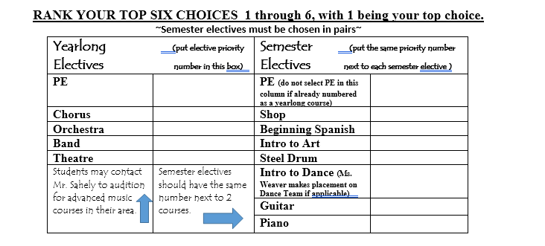

Slide 18
Important Dates to Remember!
April 17th – Course Request Forms will be sent to Elementary Schools
May 12th – Course Requests returned to Raa from Elementary Schools
July 18, 19, or 20 – One Day Orientation Camps – Spots are limited!
May 1st-3rd – Raa Dance Team Tryouts
Stay tuned to your email (ListServ)for other Performing Arts Program’s Tryouts!
Notes:
Elementary is handling the distribution and collection of the forms. Any questions regarding the form itself, direct to me.

